Slide 1
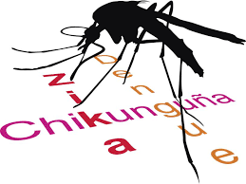
MONMOUTH COUNTY HEALTH DEPARTMENT ZIKA VIRUS: POTENTIAL PUBLIC HEALTH IMPACT IN OUR COMMUNITIES
May 19, 2016
PRESENTED BY: PREETHI SUBRAMANYA,
PUBLIC HEALTH EPIDEMIOLOGIST

Slide 2
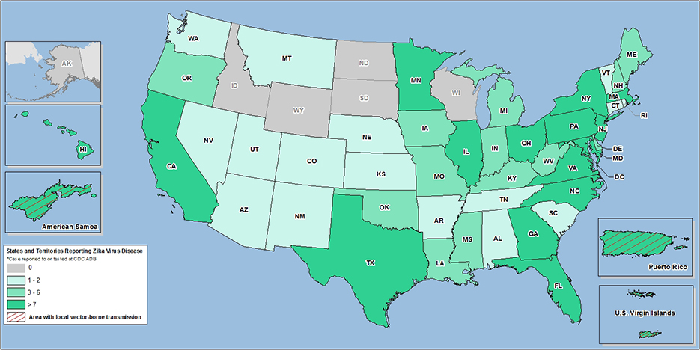
Zika virus disease in the United States, 2015–2016

Slide 3
COMMUNICATIONS
Public Call Center
800-962-1253
WEBSITE
www.nj.gov/health/cd/zika
https://co.monmouth.nj.us/page.aspx?ID=4672
Notes:
*NEW Public Call Center Open
The NJDOH and New Jersey Poison Information and Education System (NJPIES) have collaborated on a public call center for individuals who have questions about Zika. Please share this information with your patients, colleagues and neighbors.
The call center is open 24 hours a day and is staffed by professionals who can answer questions from the general public and health care professionals. The call center has the capability to answer questions in any language.
The call center telephone number is: 800-962-1253
Web Updates:
The NJDOH Zika information website includes updated Zika Key Messages, and brief Zika advisory videos in English, Spanish, French Creole, and Portuguese. You can find the videos at www.nj.gov/health/cd/zika; click on the Public Health TV icon in the lower right corner. There is also a link to the new CDC Zika Prevention Kit infographic.

Slide 4
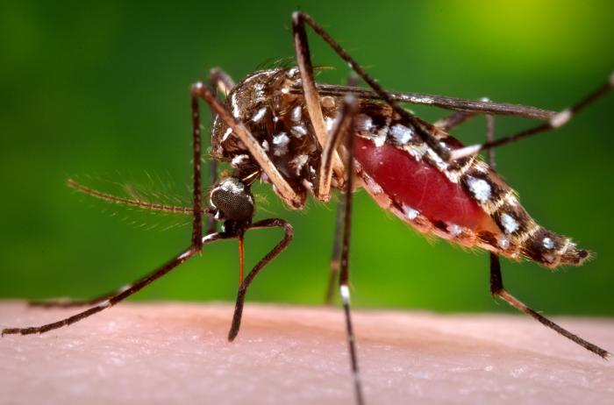
What is ZIKA Virus(ZIKA)?
Viral infection caused by the bite of an infected mosquito

Slide 5
SIGNS & SYMPTOMS
1 IN 5 PEOPLE ACTUALLY SHOW SYMPTOMS.
Fever, rash, joint pain, conjunctivitis (red eyes), muscle pain and headache.

Slide 6
TRANSMISSION

Slide 7
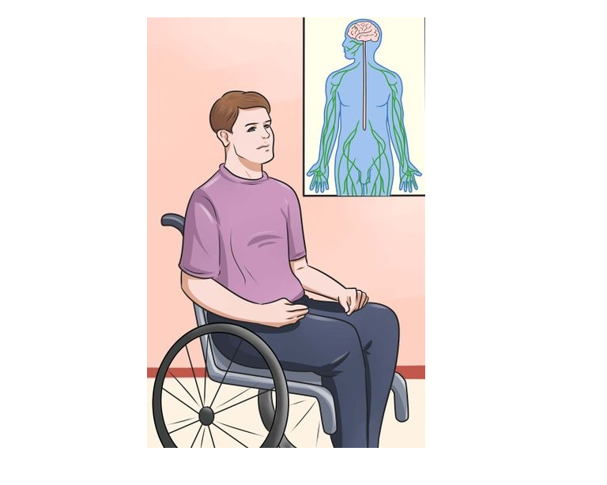
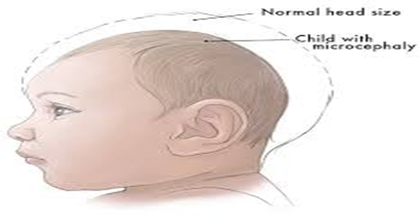
COMPLICATIONS
MICROCEPHALY
GULLIAN BARRE SYNDROME
Notes:
GBS: Immune system attacks the nerves and leads to weakness and temporary to permanent paralysis.
Microcephaly: A birth defect where the babies are born with a head size much smaller than a normal head size.
The brain is underdeveloped and many of these babies may not live past a year and if they do they may have severe neurologic & developmental problems.

Slide 8
FACT CHECK
Zika is not an airborne disease and cannot be spread by coughing, sneezing or talking.

Slide 9
PREVENTION
MOSQUITO REPELLENTS
AVOID TRAVEL IF PREGNANT OR PLANNING PREGNANCY
USE CONDOMS

Slide 10
REFERENCES
http://www.cdc.gov/mmwr/volumes/65/wr/mm6503e2.htm?s_cid=mm6503e2.htm_w
http://medicalxpress.com/news/2016-02-colombia-explosion-nerve-disease-zika.html
http://www.ncbi.nlm.nih.gov/pmc/articles/PMC2883091/
www.CDC.GOV/HEALTH
New Jersey State Department of Health

